Slide 1
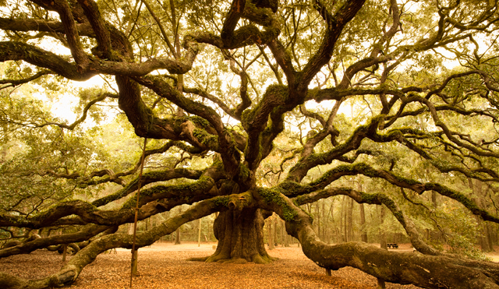
How Come Dumbledore Knows Everything?
Trees
(Trees)
Chris Piech
CS 106B
Lecture 18
Feb 8, 2016
CS 106B
2011

Slide 2

Socrative
Room: 106BWIN16

Slide 3

Today’s Goal
Be able to define a tree
Be able to traverse a tree

Slide 4




Today’s Route
Friday
Pensive?
Gameshow
First Tree
Formal
Trees
Tree River

Slide 5

Today’s Route
Friday
Pensive?
Gameshow
First Tree
Formal
Trees
Tree River

Slide 6

Recursive Exploration

Slide 7
Decision Trees
Undergrad
Oceanography
Native Studies
CS
AI
HCI
Graphics
CompBio
Research
Startup

Slide 8
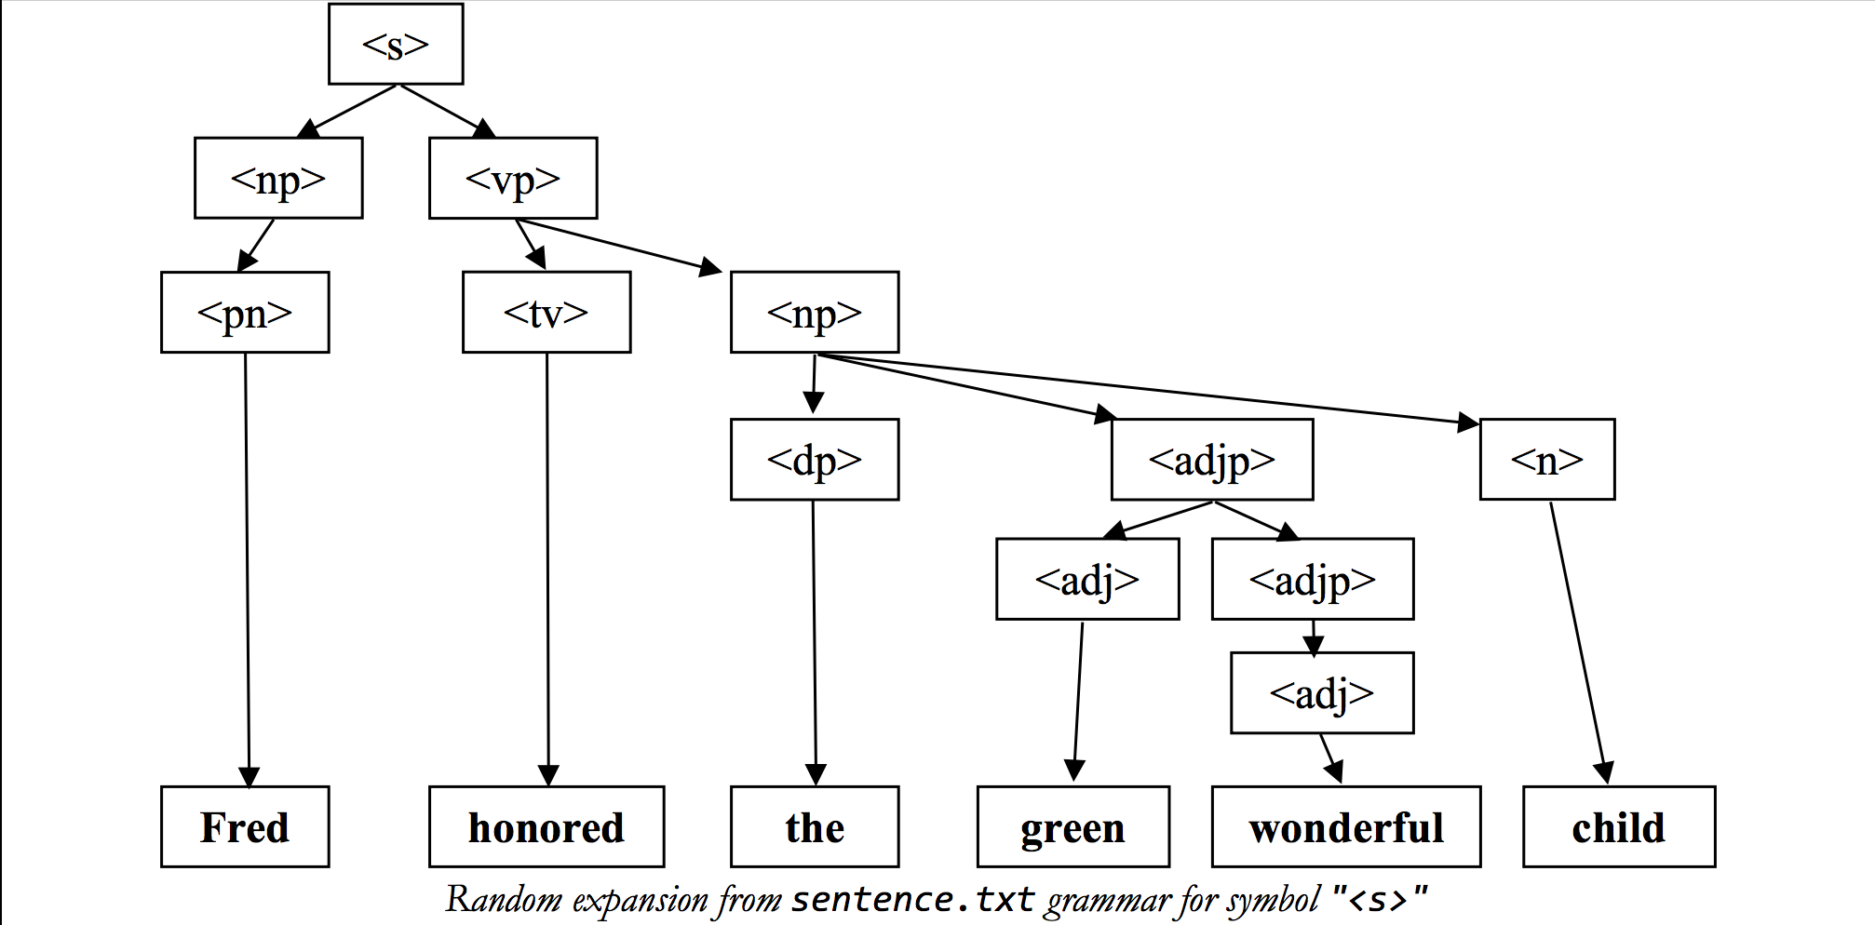
Syntax Tree

Slide 9
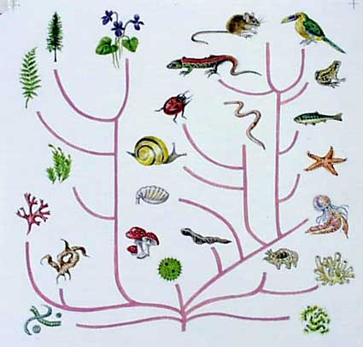
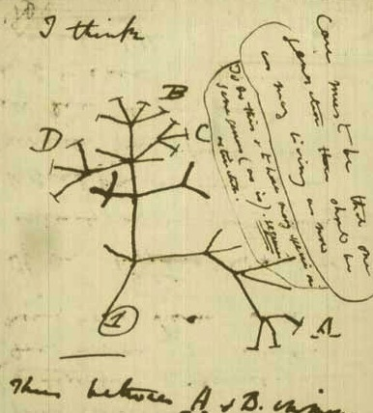
Animal Tree

Slide 10
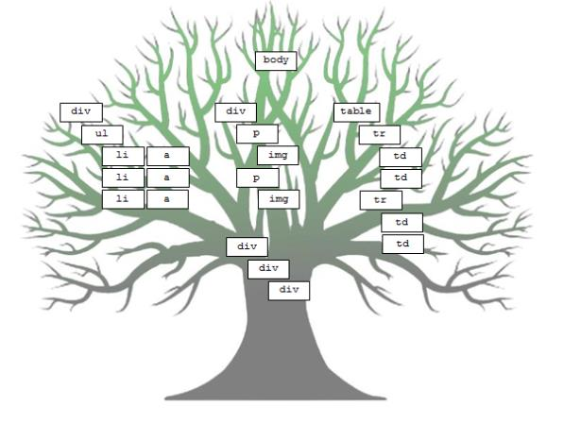
Websites

Slide 11
Hierarchies
world
China
Honduras
USA
Shanghai
Hunan
Tegucigalpa
California
Ohio
Changsha
SF
LA
Kent

Slide 12
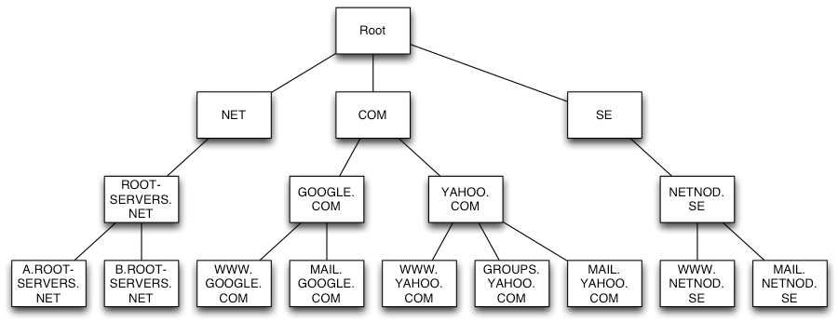
Internet Domains

Slide 13
We have seen: Recursion on Trees

Slide 14
But How About Making a Tree Variable?

Slide 16
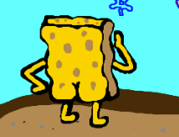

Slide 17
Binary Tree:

Slide 18
Binary Tree:
value

Slide 19
Binary Tree:
value

Slide 20
value
value
value

Slide 21
value
value
value

Slide 22
Most Important Slide

Slide 23
Binary Tree
struct Tree {
string value;
Tree * left;
Tree * right;
};
value

Slide 24
Does value have to be a string?

Slide 25
No

Slide 26
Binary Tree
struct Tree {
string value;
Tree * left;
Tree * right;
};
value

Slide 27
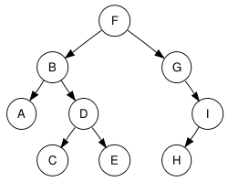
Example Binary Tree
struct Tree {
char value;
Tree * left;
Tree * right;
};

Slide 28
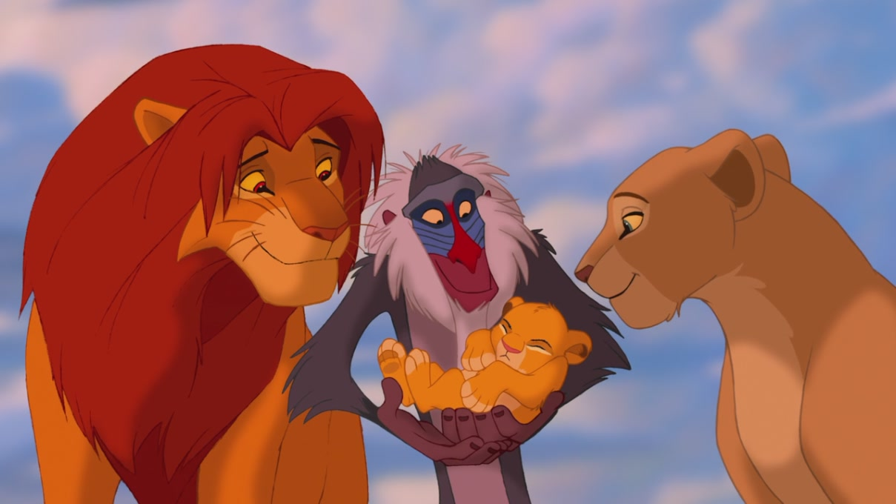
Pointers
Recursion
Trees

Slide 29
Terminology

Slide 30
Terminology
William I
William II
Henry I
William
Matilda

Slide 31
Terminology
William I
William II
Henry I
William
Matilda
We call a single element a “Node” or “Tree”

Slide 32
Terminology: Parent
William I
William II
Henry I
William
Matilda
We call the Tree that points to us our “Parent”

Slide 33
Terminology: Children
William I
William II
Henry I
William
Matilda
We call the nodes that we point to our “Children”

Slide 34
Terminology: Siblings
William I
William II
Henry I
William
Matilda
We call nodes that share the same parent “Siblings”

Slide 35
Terminology
William I
William II
Henry I
William
Matilda

Slide 36
Terminology
depth
William I
William II
Henry I
William
Matilda
The depth of a node is the number of links from the root.

Slide 37
Terminology
depth
William I
William II
Henry I
William
Matilda
The depth of a tree is the maximum number of links from the root.

Slide 38
Terminology
William I
William II
Henry I
William
Matilda

Slide 39

Terminology
William I
William II
Henry I
William
Matilda

Slide 40
Terminology
William I
William II
Henry I
William
Matilda
We call nodes that have no children “Leaves”

Slide 41
Terminology
William I
William II
Henry I
William
Matilda
We call nodes that have children “Inner Nodes”

Slide 42
Terminology
William I
William II
Henry I
William
Matilda
We call the node without parents the “Root”

Slide 43
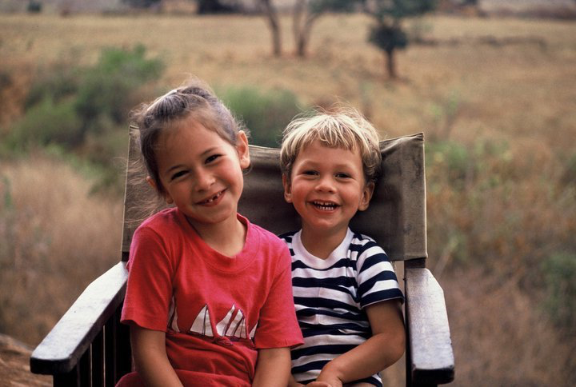
Why Binary?
Exactly two children

Slide 44
End Terminology

Slide 45


Tree Definition
Only One Parent
No Cycles

Slide 46
Only One Parent
S
N
A

Slide 47
Only One Parent
S
N
A
This is not a tree because the red node has two parents

Slide 48
Only One Parent
S
N
T
A
F
O
This is not a tree because the red node has two parents

Slide 50
No Cycles
S
T
A
N

Slide 51
No Cycles
S
T
A
N
This is not a tree because the red edges make a cycle

Slide 53
No Cycles
S
T
A
N

Slide 54
No Cycles
S
T
A
N
This is not a tree because the red edges make a cycle

Slide 55
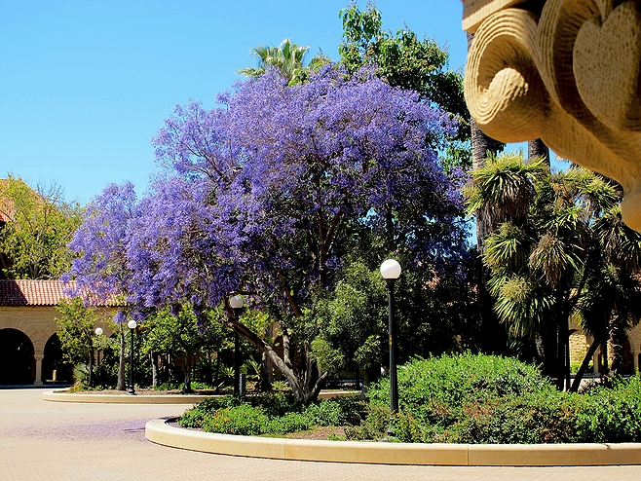
Other Kinds of Trees
One of my favorite trees

Slide 56
Trinary Tree
struct Tree {
string value;
Tree * left;
Tree * middle;
Tree * right;
};
value

Slide 57
Tree
struct Tree {
string value;
Vector<Tree *> children;
};
value
…

Slide 58
Structs or Classes
struct Tree {
string value;
Tree * left;
Tree * right;
};
struct Tree {
// some value
Vector<Tree *> children;
};
class Tree {
private:
string value;
Vector<Tree *> children;
};
struct Tree {
// some value
Vector<Tree *> children;
};

Slide 59

How Many Valid Binary Trees?
A) 3 B) 4 C) 5 D) 6 E) 7
NULL

Slide 60
How Many Valid Binary Trees?
A) 3 B) 4 C) 5 D) 6 E) 7
NULL

Slide 61
How Many Valid Binary Trees?
A) 3 B) 4 C) 5 D) 6 E) 7
NULL

Slide 62
How Many Valid Binary Trees?
A) 3 B) 4 C) 5 D) 6 E) 7
NULL

Slide 63
How Many Valid Binary Trees?
A) 3 B) 4 C) 5 D) 6 E) 7
NULL

Slide 64
How Many Valid Binary Trees?
A) 3 B) 4 C) 5 D) 6 E) 7
NULL

Slide 66
Today’s Route
Friday
Pensive?
Gameshow
First Tree
Formal
Trees
Tree River

Slide 67
Today’s Route
Friday
Pensive?
Gameshow
First Tree
Formal
Trees
Tree River

Slide 68



Slide 70
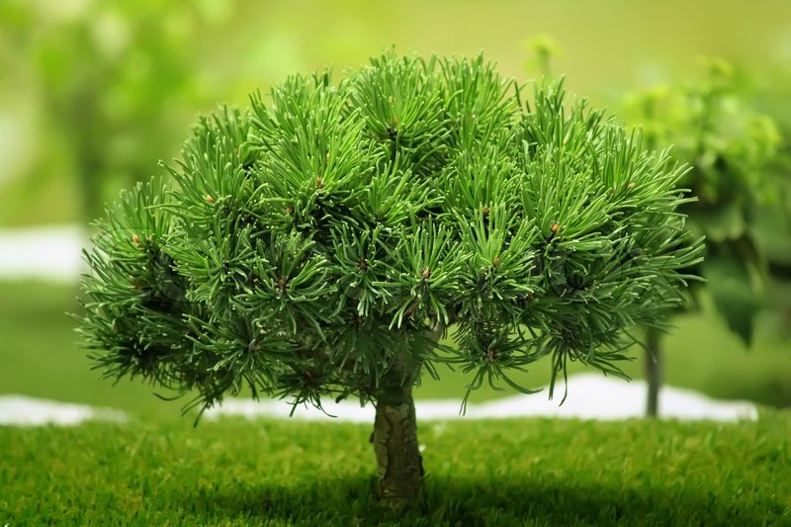

Slide 71
Cout This Tree
S
T
O
A
F
D
R
N

Slide 72
NULL Children
S
T
O
A
F
D
R
NULL
NULL
NULL
NULL
NULL
NULL
NULL
N
NULL
NULL

Slide 74
Today’s Route
Friday
Pensive?
Gameshow
First Tree
Formal
Trees
Tree River

Slide 75
Today’s Route
Friday
Pensive?
Gameshow
First Tree
Formal
Trees
Tree River

Slide 76
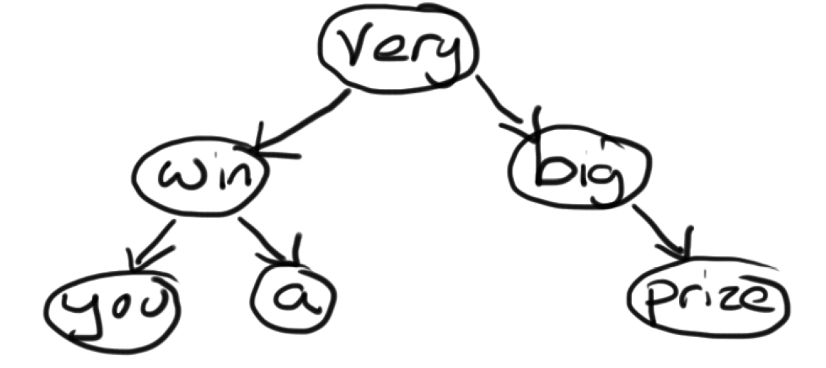
Game Show Tree

Slide 77

Game Show Tree

Slide 78
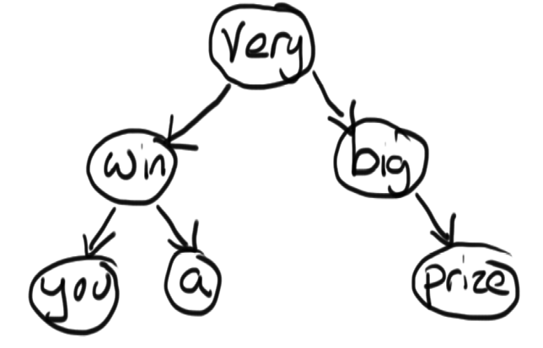
Game Show Tree
struct Tree {
string value;
Tree * left;
Tree * right;
};

Slide 79
Game Show Tree
int main() {
introduction();
Tree * tree = initTree();
int choice = getUserChoice();
suspense();
switch (choice) {
case 1: doorOne(tree); break;
case 2: doorTwo(tree); break;
case 3: doorThree(tree); break;
}
return 0;
}

Slide 80
Game Show Tree
void doorOne(Tree * tree) {
if(tree == NULL) return;
cout<<tree->value<<” “;
doorOne(tree->left);
doorOne(tree->right);
}
void doorTwo(Tree * tree) {
if(tree == NULL) return;
doorTwo(tree->left);
cout<<tree->value<<” “;
doorTwo(tree->right);
}
Void doorThree(Tree * tree) {
if(tree == NULL) return;
doorThree(tree->left);
doorThree(tree->right);
cout<<tree->value<<” “;
}

Slide 81


Slide 82
Today’s Route
Friday
Pensive?
Gameshow
First Tree
Formal
Trees
Tree River

Slide 83
Today’s Route
Friday
Pensive?
Gameshow
First Tree
Formal
Trees
Tree River

Slide 84
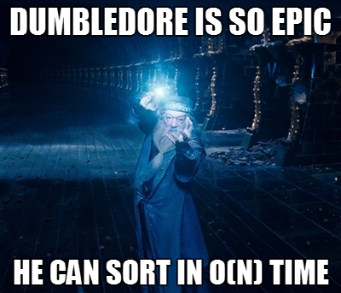

Slide 85
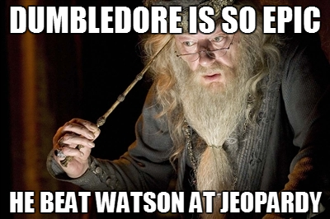

Slide 86
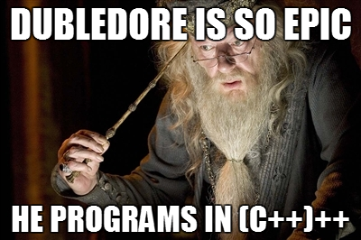

Slide 87
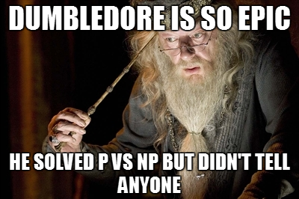

Slide 88
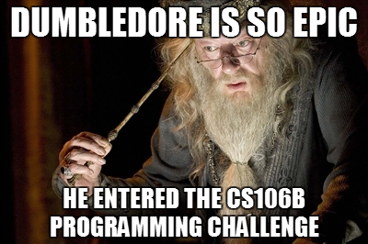

Slide 89
How come Dumbledore knows everything?

Slide 90
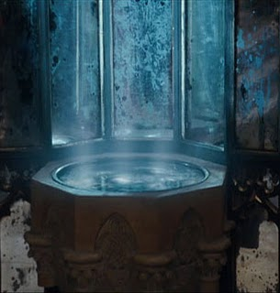
Pensive

Slide 91
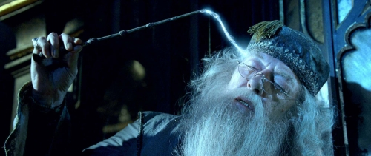
Pensive Demo

Slide 92
Pensive
Wizard?
no
yes
Dudley?
Harry?

Slide 93
Pensive
Wizard?
no
yes
Harry?
Fruit?
no
yes
Dudley?
Apple?

Slide 94

* actually Yoda. But what ever

Slide 95
Today’s Route
Friday
Pensive?
Gameshow
First Tree
Formal
Trees
Tree River

Slide 96

Today’s Goal
Be able to define a tree
Be able to traverse a tree

